Slide 1
Advanced forensic methods & tools
Defense Against The Dark Arts
Christiaan Beek (@ChristiaanBeek)
IntelSecurity / McAfee Labs

Slide 2
CORE WINDOWS FORENSICS
Core Windows Forensic Investigation Techniques

Slide 3
INVESTIGATION METHODOLOGY
REFRESH on where we are in the investigation methodology…
Questions to answer
Investigator mindset

Slide 4
Windows registry primer
Virtually everything done in Windows refers to or is recorded into the Registry
A central hierarchical database used in Microsoft Windows 9x, Windows CE, Windows NT, and Windows 2000 used to store information necessary to configure the system for one or more users, applications and hardware devices
RegMon (Sysinternals) can be used to display registry activity in real time.
Registry access barely remains idle. The Registry is referenced in one way or another with every action taken by the user

Slide 5
Structure of the windows registry
By opening the Registry Editor (by typing ‘regedit’ in the run window), the Registry can be seen as one unified “file system”
The five most hierarchal folders are called ‘hives’ and begin with ‘HKEY’ (an abbreviation for Handle to a Key)
Although five hives can be seen, only two of these are actually ‘real’, HKEY_USERS (HKU) and HKEY_LOCAL_MACHINE (HKLM)
The other three are shortcuts or aliases to branches within one of the two hives

Slide 6
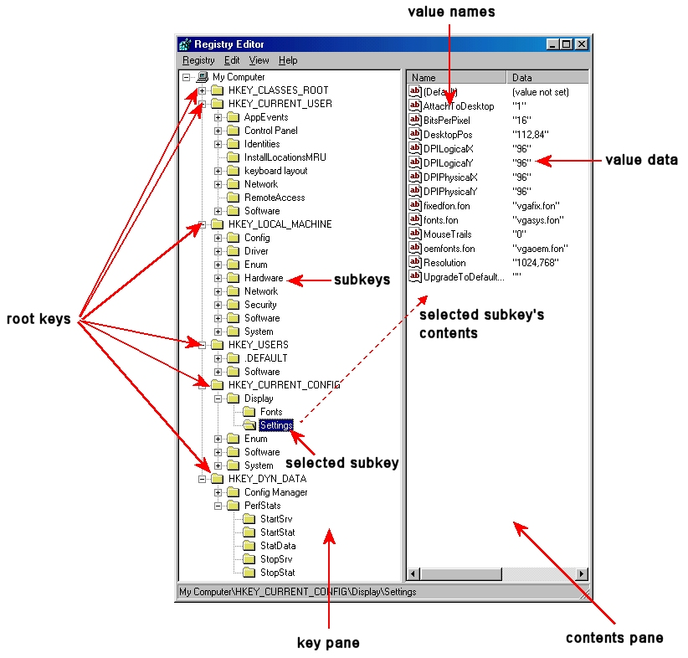
Structure of the windows registry
Each of these five hives is composed of keys, which contain values and subkeys
Values are the names of certain items within a key, which uniquely identify specific values pertaining to the operating system, or to applications that depend upon that value

Slide 7
The registry as a forensic log
AutoRun locations
MRU lists
UserAssist
Geolocation: Wired and Wireless Networks
USB devices
Internet Explorer: Typed URLs
Etc…
This section is still WIP

Slide 8
TIMELINE CREATION AND ANALYSIS
Once you obtain that information you could check file access, creation and modify times around that period to get some idea of the actions that took place on the system and the files the attackers touched
Furthermore, you can correlate that with other time stamped files like windows events logs and application logs to get a bigger picture
That timing of events, or timeline, usually becomes the centre of your investigation, although you must be aware that an attacker can easily modify file times

Slide 9
TIMELINE CREATION AND ANALYSIS
There are several ways of creating a timeline using different tools
Volatility (timeline from memory-dump)
$MFT (Master-file-table you acquired during the first response)
Reg-Ripper

Slide 10
Lab 4:Creating timeline of $MFT
Analyzing the $MFT for events

Slide 11
FILES AND DIRECTORY ANALYSIS
So what should you look for next? Well, the following is a brief list of things you should be looking when browsing the offline filesystem:
Relevant files (pagefile.sys, index.dat, etc…)
Windows event logs
Application configuration files and logs
Prefetch folder
Evidence of malware, rootkits, etc
In many cases the target system is a VM – What do you need to know to acquire the VM in it’s original state / what are benefits?

Slide 12
FILES AND DIRECTORY ANALYSIS
Event logs (Application, System, Security, DNS)
very useful, many tools to extract
IIS/webserver/FTP logs/URLScan
useful to detect webapp exploiting (maybe as point of entry), for example unicode attacks, sql injection, ...
Windows Firewall log (%windir%\pfirewall.log)
Dr. Watson logs
contain information about processes running when an application crashed
setupapi.log
information about installation of applications and devices
schedlgu.txt
information about scheduled tasks
Antivirus / IDS / IAS / ISA Server / ... logs

Slide 13
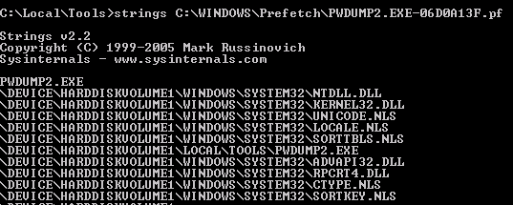
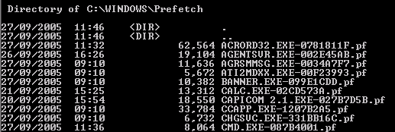
Prefetch folder

Slide 14
Other key artifacts
System Restore Points
Pagefile.sys
Hybernation file
Crash-dump files
LNK files
Shell-bag
Etc…

Slide 15
Data recovery
This process recovers files or data deleted or in slack from the system
Identify when the files where deleted
Look for file fragments and unrecoverable data
Recover pertinent files, including images and emails
Describe methods in detail in your report

Slide 16
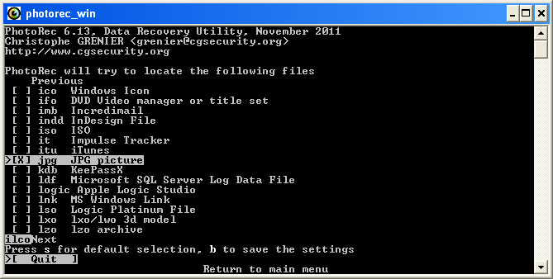
Data recovery with Photorec
Carves out files in an image based on headers
Output directory will contain all files recovered

Slide 17
Lab 4: Recovering Data
Hands on exercise with PhotoRec

Slide 18
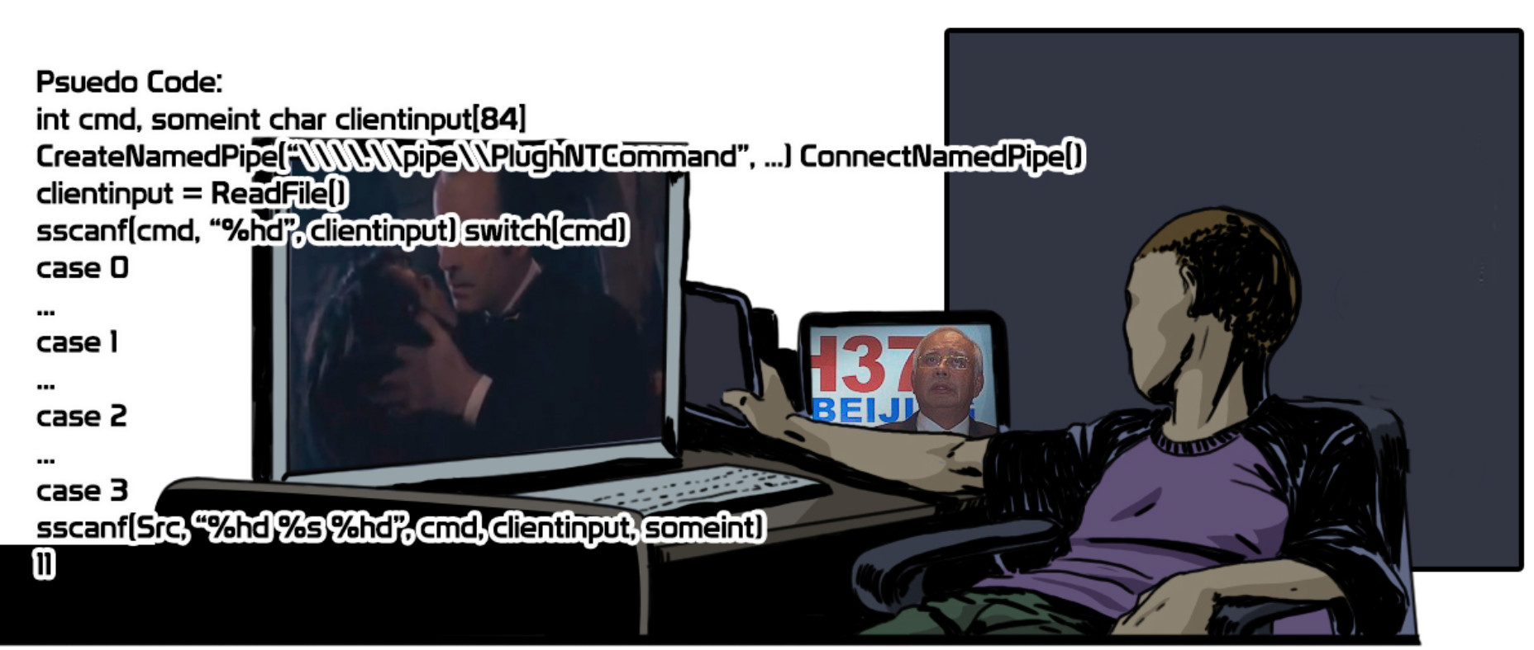
The (malware) forensic challenge

Slide 19

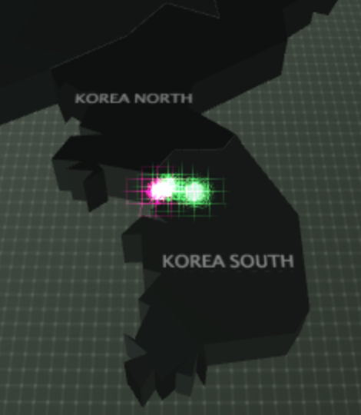
The case:
A DPRK Defector was caught close to the border of North and South Korea.
The person was member of DPRK’s Unit 21 – Cyber-Army Division
The person had an USB-stick hidden in his clothes
An image was made of the USB-stick
Your task: Investigate the disk
This message will self-destruct in 5 seconds………

Slide 20

The case:

Slide 21
The CASE:
Team up – 3 persons per team
First team that answers the answers right will win the cake!
Winning team has to present the results to the class.
Questions:
1. What is/are the cyber-target(s) found on the USB-stick?
2. Investigate possible malware and describe the working
Display the list of usernames/passwords?
What was the offset-value you find them?
Which relevant files were deleted and can you replicate them?
5. What strategy would you advice to the target(s)
Take notes for your home-work assignment: write-up your analysis of this case!
Notes:
Two South-Korean Oil companies with names and ip-addresses – found in password protected zip file
SMB malware spreading inside are usernames and passwords – Xor: 0x67
3EBBD –
Carving using Photorec – two picture files
Change passwords, extra rules for detection, harden the ip-addresses etc.

Slide 22
The CASE:

Slide 23
Questions?
Christiaan_Beek@mcafee.com / @ChristiaanBeek

